Slide 1
401MAN Business Environment

Slide 2
Stakeholder analysis and environmental scanning

Slide 3
Learning Objective
By the end of the lesson you will be able to:
Describe what is meant by a stakeholder and who they are
Understand how stakeholders analysis can help a business
Conduct stakeholder analysis using the stakeholder assessment matrix

Slide 4

Environmental Scanning
A process by which an organisation monitors both its internal and external environment to better achieve sustainable competitive advantage
It involves monitoring, evaluating and dissemination of information about occasions, patterns, trends and relationships within an organisations internal and external environment
Understanding the environment of a business makes it easy to identify the approaches a manager or business will use to audit the business environment

Slide 5
Approaches to environmental scanning
Internal analysis
SWOT
Value chain analysis
The resource-based view (VRIO framework)
Standards for comparison
External analysis
PESTLE framework
LoNGPESTLE
Porter’s five forces
Porter’s diamond model
Industry life cycle analysis
Example: A critical analysis of the internal and external environment of Apple Inc

Slide 6
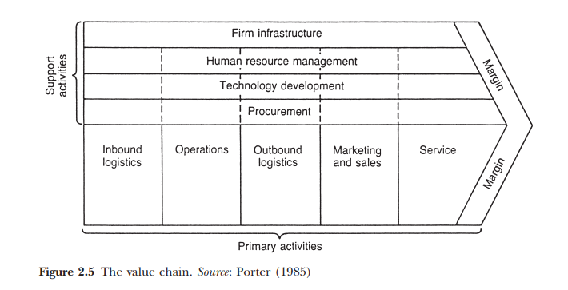
Internal Analysis
Internal Linkages:
Optimization
Coordination
Dabson, Starkey & Richard (2004)

Slide 7
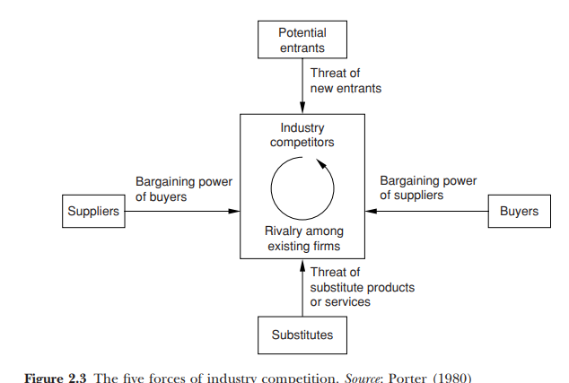
External Analysis
Dabson, Starkey & Richard (2004)

Slide 8
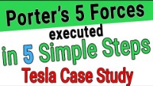
Porters Five Forces

Slide 9
Activity
Carry out an analysis of a business from the selected sector, using on the of the frameworks below.
Internal analysis
SWOT
Value chain analysis
The resource-based view (VRIO framework)
Standards for comparison
External analysis
PESTLE framework
LoNGPESTLE
Porter’s five forces
Porter’s diamond model
Industry life cycle analysis

Slide 10
Organisations and Stakeholders
Any person or organisation who can be positively or negatively impacted by, or cause an impact on the actions of a company (Freeman, 1984)
Individuals and/or groups who are affected by or affect the performance of the organisation in which they have an interest (Worthington and Britton, 2006)
Individuals and constituencies that contribute, either voluntarily or involuntarily, to its wealth-catering capacity and activities, and are therefore its potential beneficiaries and/or risk bearers (Post, Preston & Sachs, 2002)

Slide 11
Classification of stakeholders
Internal
Employees
Managers
Owners/Shareholder
External
Suppliers
Society
Government
Creditors
Shareholders
Customer
Company

Slide 12
Who are Stakeholders?
Anybody that is affected by an organisation
Individuals and constituencies that contribute, either voluntarily or involuntarily, to its wealth-catering capacity and activities, and are therefore its potential beneficiaries and/or risk bearers s(Post, Preston & Sachs, 2002)
Any person or organisation who can be positively or negatively impacted by, or cause an impact on the actions of a company (Freeman, 1984)

Slide 13
They are
Those who can influence the project
Those who are affected by the project
Those who are involved in the project

Slide 14
A typical stakeholder list
Owners, stockholders and investors
Banks and creditors
Suppliers
Customers
Management
Employees
Competitors
Government and Regulators
Professional and industry association
Media
Non profit
Communities

Slide 15
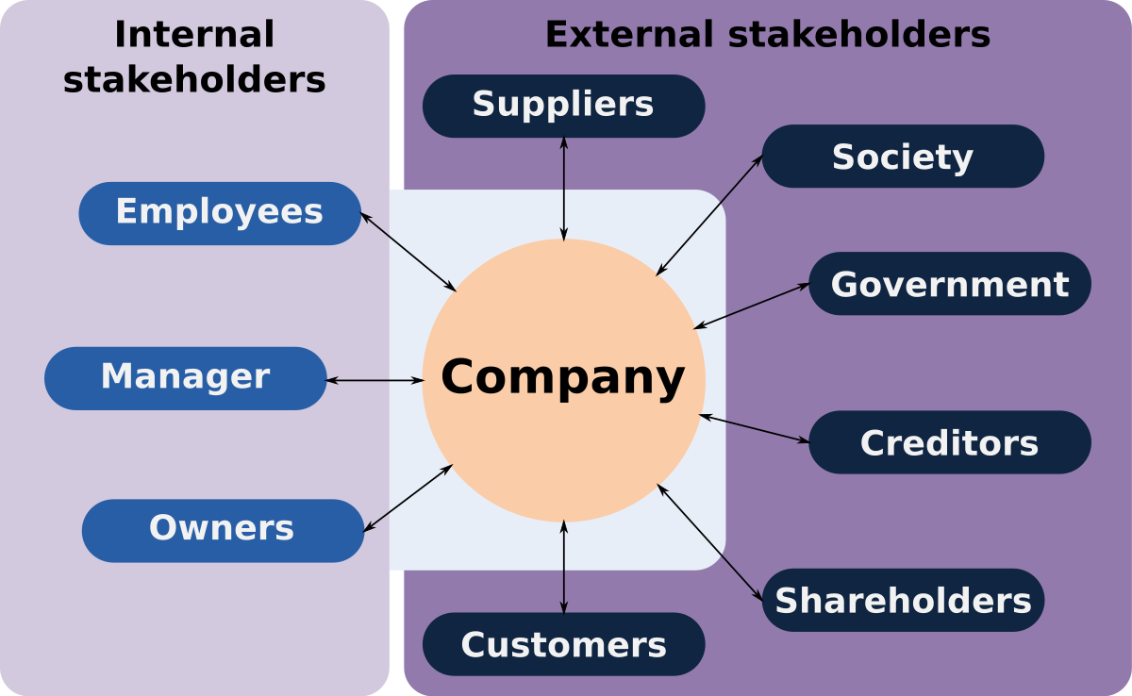
Who are stakeholders?
Mullens (2016, p38)

Slide 16
Activity – 10 minutes
Who are the stakeholders for CUW? Can you identify them?

Slide 17
Stakeholder Analysis
A technique you can use to identify and assess the importance of key individuals, groups, or institutions that may significantly influence the success of your project.
members of your quality improvement team

Slide 18
Why do an analysis?
Identify the stakeholders likely to be affected by or influence the activities of the organisation
Assess how those stakeholders could be impacted or impact upon the organisation
Anticipate the consequences of any change in the organisation’s activities
Identify stakeholder’s ‘success criteria’
Assure a successful outcome for the organisation by developing cooperation with stakeholders

Slide 19
Why do an analysis?
Identify local institutions and processes upon which to build on
Develop strategies to get the most effective support possible for your initiative and reduce any obstacles to successful implementation of your program

Slide 20
Meeting Stakeholder Needs
How do you communicate with stakeholders?
Do you communicate the stakeholder value?
Do your communications encourage stakeholder exchange?
Can you eliminate or reduce focus on processes which do not add stakeholder value?
How can you do better?
Where does your organisation create stakeholder value?

Slide 21
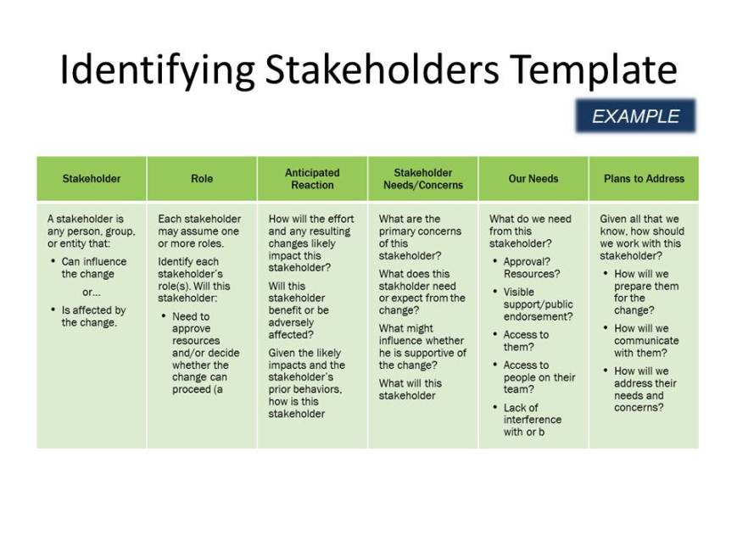

Slide 22
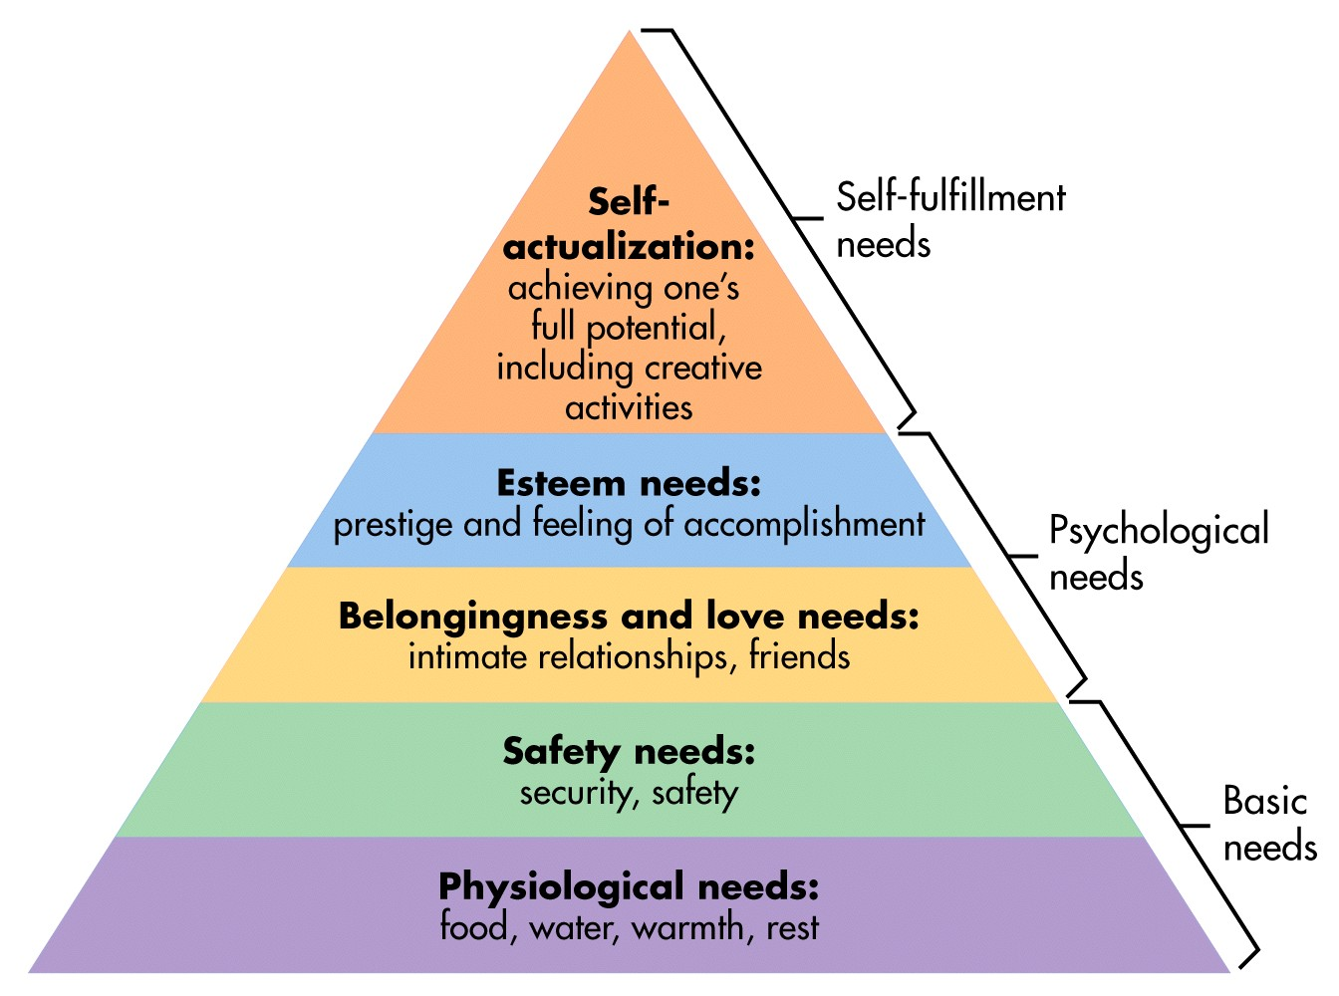
What are the interests of the various stakeholders?

Slide 23
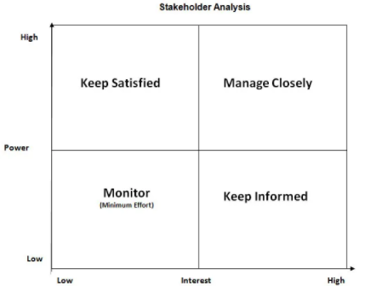
Stakeholder Mapping
High power, high interest – fully engage with them and keep them satisfied
High power, low interest – manage them closely
Low power, high interest – keep them adequately informed and ensure no major issues
Low power, low interest – monitor but don’t bore them
Power: measures the influence they have over the project and to what degree they can help achieve or block the project
Interest: measures the degree they are likely to be affected by the project, and what degree of interest or concern they have about the project/ in the project

Slide 24
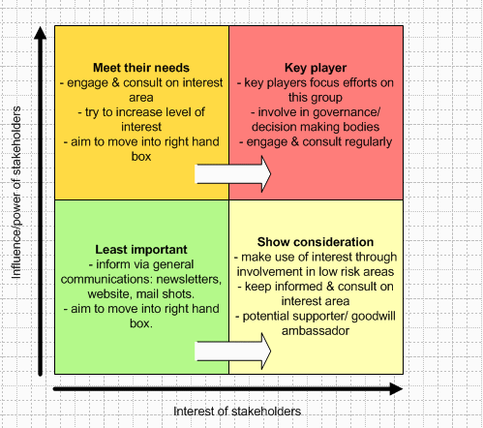

Slide 25
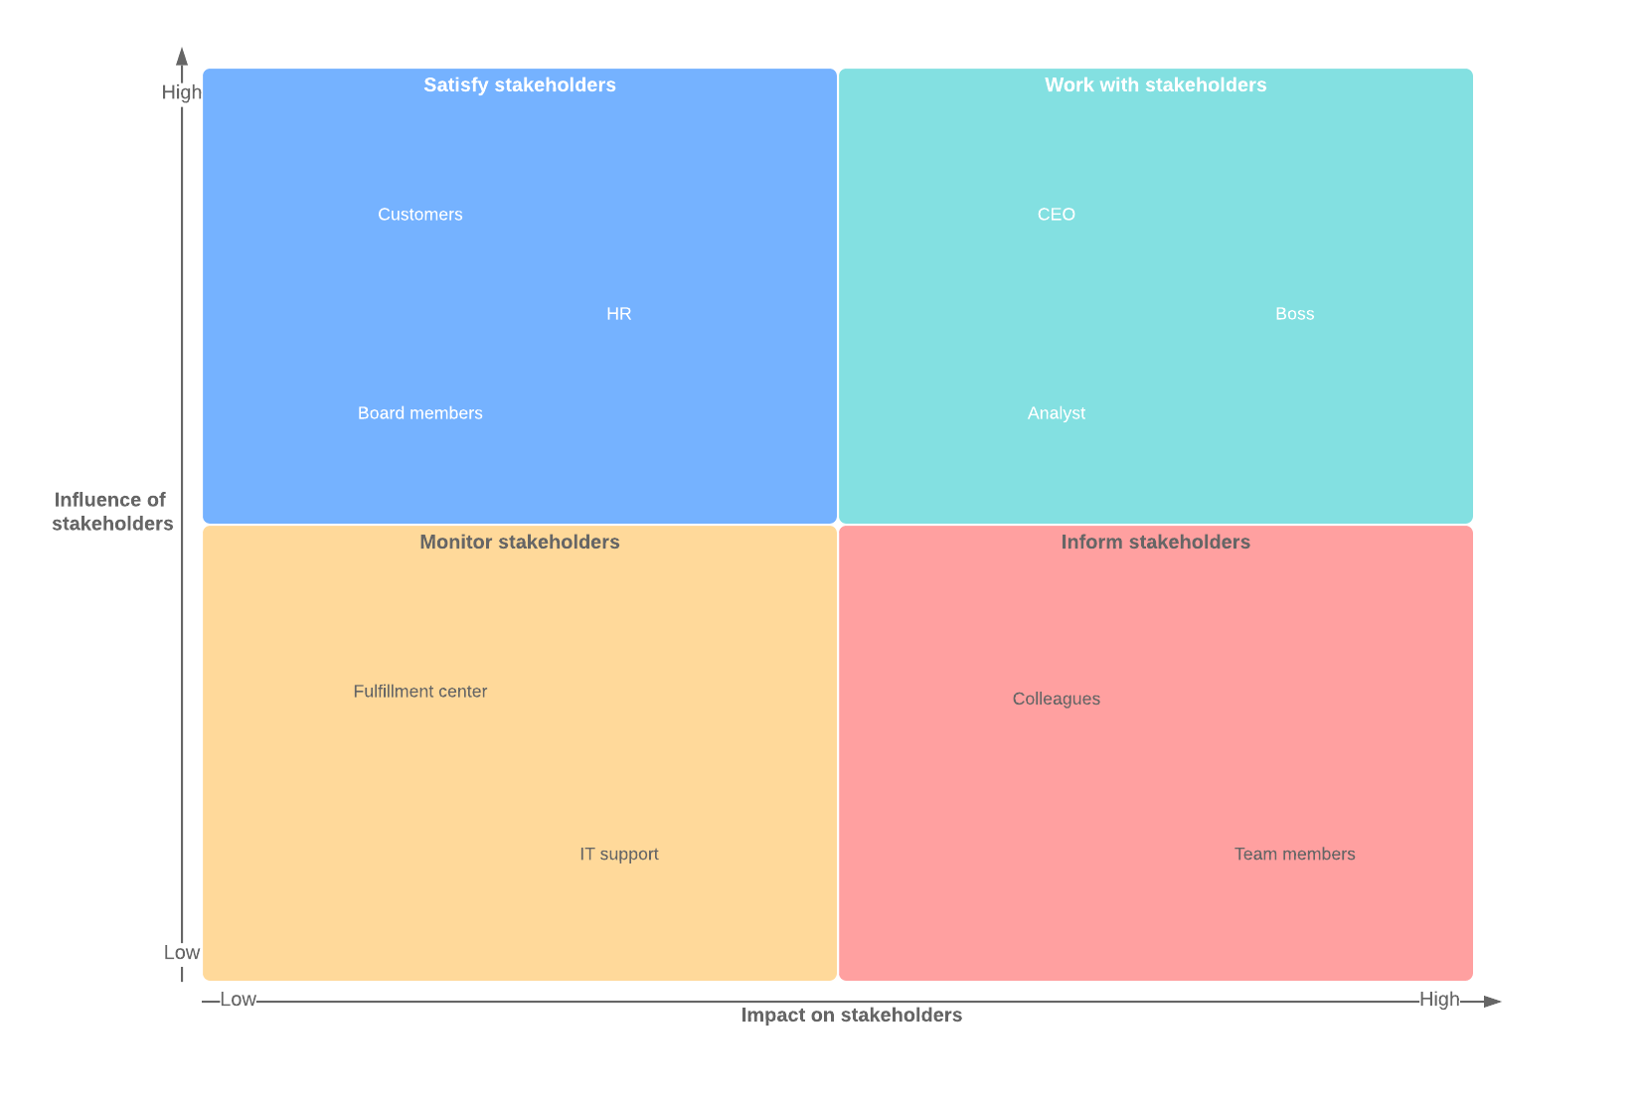
Example

Slide 26
Activity – 30 minutes
Coventry University Group wants to open another campus in Poland.* Can you identify who their stakeholders are and also do a stakeholder analysis using the matrix.

Slide 27
How to analyse
Attitude
Supportive?
Indifferent?
Opposed?
Influence
Decision makers
Policy maker
Access ‘gate keeper’
Supportive or opposed?
Interested or not interested?
Accessibility?
Open-mindedness
Willingness to use influence to change the outcome (+ve or –ve)
Approachability?
Flexibility
Ability to block if still opposed?

Slide 28
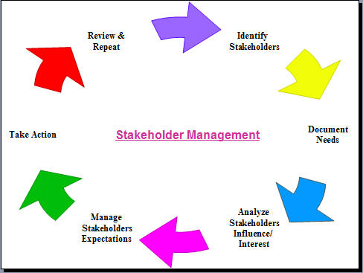
Stakeholder analysis process
Identify stakeholders - beneficiaries, vulnerable groups, supporters/oppositons
Assess impact on project – expectation, benefits, resources, conflicting interest
Assess influence – power, organisation, control of resources, personal connections, power relations
Participation strategy – plan of their involvement, interest, importance, participation in various project cycle

Slide 29
Summary of analysis
Context
Identify focus
Identify system boundaries
Application of stakeholder methods
Identify stakeholders and their stake
Differentiate between and categorise stakeholders
Investigate relationships between stakeholders
Actions
Recommend future activities and stakeholder engagement

Slide 30
References
Brevis, T. and Vrba, M. (2014) Contemporary Management Principles.
Essential Reading
Worthington, I. and Wilkinson, G. (2014) The Business Environment. 7th edn. Harlow: Pearson
Wetherly, P. and Otter, D. (2014) The Business Environment: Themes and Issues in a Globalising World. 3rd edn. Oxford: Oxford University Press
Recommended Reading
Campbell, D. & Craig, T. (2005) Organisations and the Business Environment. Oxford: Elsevier

Slide 31
References
Recommended Reading – cont’d
Capon, C. (2009) Understanding the Business Environment. 3rd edn. Harlow: Pearson
Harrison, A. (2013) Business Environment in a Global Context. 2nd edn. Oxford: Oxford University Press
Needle, D. (2015) Business in Context. 6th edn. Andover: Cengage Learning
CMI Website: Management Direct
Websites used
Prachi, M. (2019, February 18) Public limited company. The Investors Book
The Investors Book - Learn about Investing & Business related terms

